Slide 1
CMAC 3990.200
Systems Administration and Operations
Fall 2025 – Week 7.1 – October 7th, 2025
Monitoring, Install options, Remote Access with VNC
Some Review

Slide 2

Objectives
Quick NFS follow up
Monitoring and Netdata Install
Installing from Source
IP Address and DNS Updates/Review
Remote Access Services
Routes & Paths
Reverse SSH
Review

Slide 3

Weekly Info
The best time to plant a tree was 20 years ago. The second-best time is now.
Attendance
Good of the class
Midterm next week!
  Review: Thursday, October 9th, 2025
  Exam: Tuesday, October 14th, 2025
Presentation Reminder!
  December 2, 2025
Final: Tuesday December 9th, 2025 – 5:00PM to 7:00PM

Slide 4

Assignment Reviews
Assignment 4
  Network Bond
  LDAP Logins
  Samba
  SELinux
Assignment 5 Review – AWS Educate
  AWS Management Console Course
Assignment 6
  Project Proposal
Assignment 7 Review – AWS Educate
  Introduction to Cloud 101 Course

Slide 5
Upcoming Assignments
Assignment 8 – Due Oct 17!
  Review assignment for the midterm
  We will review after the midterm…
Assignment 9 – Due Oct 24?
  Extra documentation!
    Command Log - A log of the specific commands you ran, in order. Include a minimal description of the command.
    Project Work Log - Include dates, time spent on tasks, description of activities
    Detailed instructions in plain English of what you are doing - Describe what was done and why.
    Description of your server’s functionality - Overview of what services does your machine offers.
  Key configuration items
    NFS, DNS, Netdata, Network Interfaces, Apache, rsync, cron, backups, etc…
    Most everything detailed in today’s slide deck
      Specific ports or addresses may be different in the assignment!!!

Slide 6

Network File Systems (NFS) Client Install
Mapping a NFS share to a local mount point
  Install NFS Client tools (should already be installed)
    dnf install nfs-utils
  Create the local folder to mount at
    mkdir /home/students
  Add network mount to filesystem configuration file /etc/fstab
    147.64.243.110:/home/students /home/students nfs rw,sync,hard,intr,bg 0 0
  Reload systemctl and mount any missing filesystems from /etc/fstab file
    systemctl dameon-reload; mount -a
  Check that filesystem has been mounted
    df –h /home/students
      147.64.243.110:/home/students 20G 175M 20G 1% /home/students
  Manually unmount and remount network file system
    umount /home/students
    mount 147.64.243.110:/home/students /home/students
Notice the bg option!

Slide 7
NFS Setups
NFS Client – Add the following to your /etc/fstab file:
  147.64.243.110:/home/students /home/students nfs rw,sync,hard,intr,bg 0 0
  Above is a previous mount, we need to update for any new mounts!
  Don’t forget to make the folder to be used for mounting!!!
    mkdir -p /data
    echo "10.0.187.10:/data /data nfs rw,sync,hard,intr,bg 0 0" >> /etc/fstab
    mount –a
NFS Server
  Make the directory
    mkdir -p /nfs-share
  Export the necessary folder via the /etc/exports file:
    /nfs-share 147.64.242.0/23(rw,sync,root_squash)
  Don’t forget to set permissions on shares to allow others to read and write!
    chmod ugo+rwX /nfs-share

Slide 8
Netdata
A system for real-time performance and health monitoring, providing real-time insights of everything happening on the systems it runs (including containers and applications such as web and database servers), using modern interactive web dashboards.
  High resolution metrics (every second)
  Real-time visualization
  Anomaly detection
  Minimal configuration and overhead
  Integration with other monitoring infrastructure
    Slack, graphite, etc
  Monitoring of ephemeral nodes and
  auto-scaled containers
  Embedding charts into third-party applications
  https://github.com/netdata

Slide 9

Netdata Install
https://github.com/netdata/netdata/wiki/Installation
Can be installed via package managers for many Linux flavors
  Packages now available via EPEL package managers for RHEL!
  dnf install netdata
Installation on any Linux flavor can be accomplished with the following command (run as root!):
  Update your system first!
  bash <(curl -Ss https://my-netdata.io/kickstart.sh)
  Follow the on screen prompts!
    Install prerequisites (if necessary)
    Install Netdata

Slide 10
Netdata Install
Configure Netdata
  Edit /etc/netdata/netdata.conf
    In [web] section, change bind to from localhost to your IP:
      bind to = 147.64.243.1##
        This is also new!
  Start and Enable Netdata
    systemctl enable netdata --now
  Open port 19999 in the firewall to allow traffic in!
    firewall-cmd --zone=public --add-port=19999/tcp --permanent; firewall-cmd --reload
    Firewall-cmd --list-ports
  Browse to our new Netdata installation!
    http://147.64.243.1##:19999
    University firewall will prevent direct access from off-campus
      SSH tunnel? SOCKS proxy?
        Must use SOCKS PROXY!!!

Slide 11
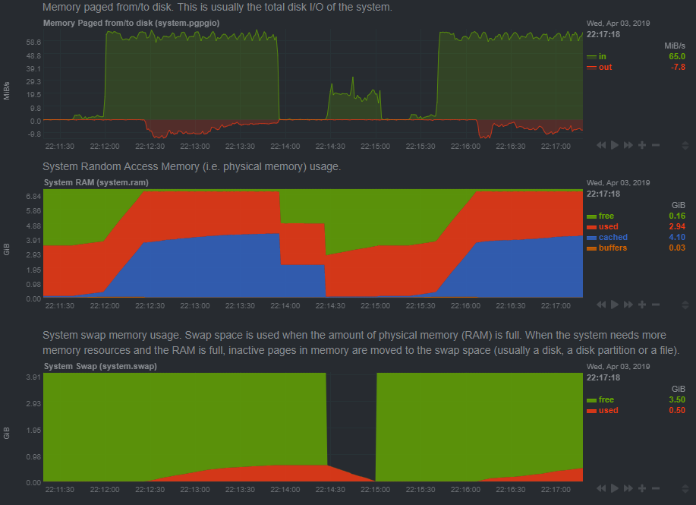
Monitoring Memory
Flush out all RAM buffers
  Orange in middle graph
  Minimal usage
  sync; echo 1 > /proc/sys/vm/drop_caches
Flush out all RAM cache
  Blue in middle graph
  sync; echo 2 > /proc/sys/vm/drop_caches
Flush buffers and cache at the same time
  sync; echo 3 > /proc/sys/vm/drop_caches
Move all swap to active RAM
  Move red from lower to middle
  swapoff -a; swapon -a
See true memory usage!
  Cache and buffers should
  be taken into account!
Notes:
rm -rf /dev/shm/fill; dd if=/dev/zero of=/dev/shm/fill bs=1k count=2048k #use some ram
find / -type f -exec cat {} >> /dev/null \; #use some cache

Slide 12
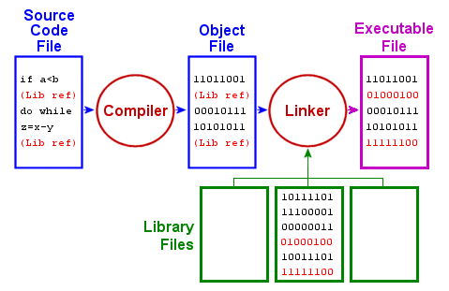
Installing From Source
Why
  Why Not?
How
  Download the source code
  Modify the source code (if necessary)
  Configure the source code to be compiled
  Make the binary and supporting files (compile & link)
  Install the binary and supporting files
Pros
  Customization, control, transparency…
Cons
  Overhead, maintenance, complexity, dependencies…

Slide 13
Apache source install
Install Apache prerequisite packages!
    dnf install apr apr-util apr-devel apr-util-devel gcc openssl-devel lynx
    dnf install pcre-devel pcre2-devel redhat-rpm-config tar
Download the latest source code tarball:
    mkdir -p /tmp/apache
    cd /tmp/apache
    wget https://dlcdn.apache.org/httpd/httpd-2.4.65.tar.gz
    tar zxvf httpd-2.4.65.tar.gz
    cd httpd-2.4.65
    ./configure
    make
    make install
    firewall-cmd --zone=public --add-port=80/tcp --permanent; firewall-cmd --reload
  Apache will be installed in /usr/local/apache2/
  Normal RHEL installs in /var/www/ and /etc/httpd/
    Ubuntu and others install to /var/www/ and /etc/apache2/

Slide 14
Apache source install
  Start apache:
    /usr/local/apache2/bin/apachectl start
  Apache does not currently run on startup, and we don’t have a systemctl startup script!
  We will add the apachectl start command to our rc.local file
  The rc.local file lets us run individual commands on startup
  Add the above line to /etc/rc.d/rc.local and set as executable
    echo "/usr/local/apache2/bin/apachectl start" >> /etc/rc.d/rc.local
    chmod +x /etc/rc.d/rc.local
  Browse to your new website at http://147.64.243.1##
    It Works!
Quick & Easy way to start on boot

Slide 15
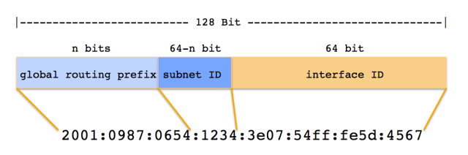
IPv6 Addresses
IPv6 – Hexadecimal notation
Base 16 (hex)
128 bit address (2^128)
IPv4 – Dotted Quad Notation
Base 2 (binary)
32 bit address (2^32)
IPv6!

Slide 16
IPv6 Addresses
IPv4 – 4.7 billion addresses
IPv6 – 340 trillion, trillion, trillion addresses
IPv4 addresses use A DNS records
IPv6 addresses use AAAA DNS records
  Example Record:
  ipv6record IN AAAA fd06:face:deaf:beef:fad:1337:0000:0001
Defining IPv6 interfaces:
    IPV6INIT=yes
    IPV6_AUTOCONF=yes
    IPV6FORWARDING=yes
    IPV6ADDR=fd06:feed:1eaf:beef:0000:0000:0000:0001/64
    IPV6ADDR_SECONDARIES="fd06:feed:1eaf:beef:cafe::1/64 fd06:feed:1eaf:beef:dead::1/64"

Slide 17

DNS
Lets add some DNS records
DNS server configuration is in /etc/named.conf
  Server configuration, allowed hosts, ports, version, etc.
Remember, our DNS zone (records) configurations are in /var/named/41##.megastuff.biz.hosts
  Note the trailing period in fully qualified records! If we omit the period, the server will append the $ORIGIN value
  If you get errors while copying and pasting these records, replace the white space with manually entered spaces!
    Record Name IN Type Value
    IN MX 10 41##.megastuff.biz.
    www IN CNAME 41##.megastuff.biz.
    ipv6 IN AAAA fd06:1234:5678:beef:01##:0000:0000:0001
    private1 IN A 10.0.187.#
    private2 IN A 10.10.1##.1
Remember to update your serial number and restart the named service!

Slide 18
Network Configs
VLAN’s – Virtual Local Area Networks
New IPv4 local VLAN
  IPv4
    nmcli con add type vlan con-name "bond-mybond0.110" dev mybond0 id 110
    nmcli con mod "bond-mybond0.110" ipv4.method manual ipv4.address "10.11.110.1##"
    nmcli con up "bond-mybond0.110"
New IPv6-only VLAN
  IPv6!
    nmcli con add type vlan con-name "bond-mybond0.6" dev mybond0 id 6
    nmcli con mod "bond-mybond0.6" ipv6.method manual ipv6.address "fd06:1234:5678:beef:01##:0000:0000:0001/64"
    nmcli con up "bond-mybond0.6"
New!

Slide 19

Remote Access Service
Gives authorized individuals a way to access the company network from home, customer sites, or other locations around the world
  Remote Access Policies!
Direct connections into network, via dial-up networks or dedicated connections
Encrypted tunnels using public internet services
  End-to-end encryption!
Low cost, easy, convenient customer access solution
  Web-based, standards based
Work-at-home solutions
  Additional potential of failure outages
  Limited to areas with high-speed internet
  Additional costs

Slide 20
Remote Access Service
Centralize remote access service administration
  Security choke points
  Limited points of entry
  Ease of management
Potential for outsourcing
  Frequently changing technologies
  Economies of scale
Protect as a guest network
  People connecting through the remote should have more restrictive access
  May have access to selected internal resources
  Separate with a vlan, routing, and different physical interfaces and devices
Guest Wi-Fi Networks
Encryption!

Slide 21

VNC
Virtual Network Computing (VNC)
  Graphical desktop sharing system that uses the Remote Frame Buffer protocol (RFB) to remotely control another computer. – Wikipedia
  Transmits keyboard, mouse, and graphics
  VNC Server – Destination of the VNC connection
  VNC Client – Source of the VNC connection
  VNC Protocol – Network protocol working at the framebuffer level
    RFB – Remote Framebuffer Protocol
  Typically not encrypted!
    Traffic protocol is inherently insecure
    Encrypt through secure SSH tunnels!
      -L 5901:127.0.0.1:5901
  TCP Connection
    Typically at ports 5900-5999

Slide 22
VNC
Quick Install 1/2
  Set up VNC connection to OS GUI
  Install Tiger VNC server software
    dnf -y install tigervnc-server
  Copy the service file in place
    This file provides the startup services for user #1, on port 5900+1!
      cp /lib/systemd/system/vncserver@.service /etc/systemd/system/vncserver@:1.service
  Add TCP firewall port 5901
    firewall-cmd --zone=public --add-port=5901/tcp --permanent; firewall-cmd --reload

Slide 23
VNC
Quick Install 2/2
  Switch to user and run the vncserver command to create a vnc password
    su – user
    vncserver
  Set new service to run at boot
    systemctl daemon-reload
    systemctl enable vncserver@:1.service --now
  Attempt to open a VNC connection to your server on port 5901!
Use the username user!

Slide 24
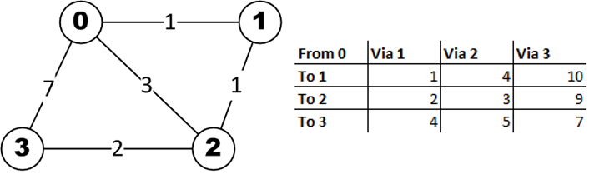
Routing Costs Example

Slide 25
CMAC 3990.200
Systems Administration and Operations
Fall 2025 – Week 7.2 – October 9th, 2025
Reviews and updates

Slide 26

Objectives
SSH Tunnel refreshers
Some DNS updates
A little about Backups
Review for Midterm
Assignment 9 Stuff

Slide 27
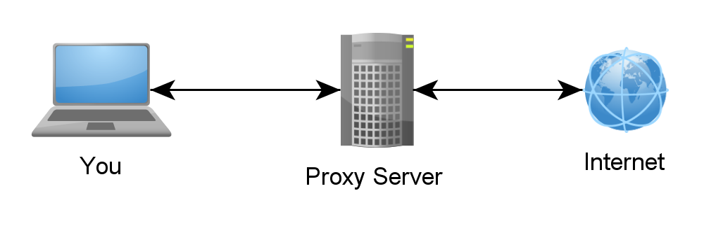
SSH Tunnels
SSH Tunnels are secure and encrypted between endpoints!
Local port forwarding
  Similar to port forwarding on a router
  ssh -L source_port:destination_host:destination_port user@host.tld
    Ex: ssh –L 8080:cmac3990-110.cs.edinboro.edu:80 cs_student@jpatalon.cs.edinboro.edu
    This command opens an encrypted tunnel between my local machine and ssh server jpatalon.cs.edinboro.edu
    Traffic sent to localhost port 8080 is redirected to cmac3990-110.cs.edinboro.edu port 80

Slide 28
SSH Tunnels
SOCKS (Dynamic) Proxy
  Allows for website proxying
  Can be used to allow connections around firewalls
    Connect to your cmac3990 web server from anywhere through an intermediate host
  ssh -D port user@host.tld
    Ex: ssh –D 55510 cs_student@jpatalon.cs.edinboro.edu
    This command opens an encrypted tunnel between your local machine and ssh server jpatalon.cs.edinboro.edu
    Web SOCKS traffic is sent through port 55510 to server jpatalon.cs.edinboro.edu, where it is then forwarded to the destination

Slide 29
SSH Tunnels
Combined SSH SOCKS proxy and local tunnels
  ssh –D 55510 –L 33890:147.64.243.110:3389 cs_student@jpatalon.cs.edinboro.edu
  This creates a tunnel through server jpatalon.cs.edinboro.edu
  This allows us to do both a local port forward and a dynamic port forward
  Connecting to localhost port 33890 is forwarded to 147.64.243.110 port 3389 through jpatalon.cs.edinboro.edu
  A dynamic SOCKS proxy is set up through localhost port 55510
  The connection is encrypted between the localhost and jpatalon.cs.edinboro.edu

Slide 30
SSH Tunnels
Multi-hop ssh tunnels
ssh -D 55555 -L 55556:127.0.0.1:55556 -L 55557:127.0.0.1:55557 cs_student@jpatalon.cs.edinboro.edu
ssh -D 55556 -L 55557:127.0.0.1:55557 user@147.64.243.110

Slide 31
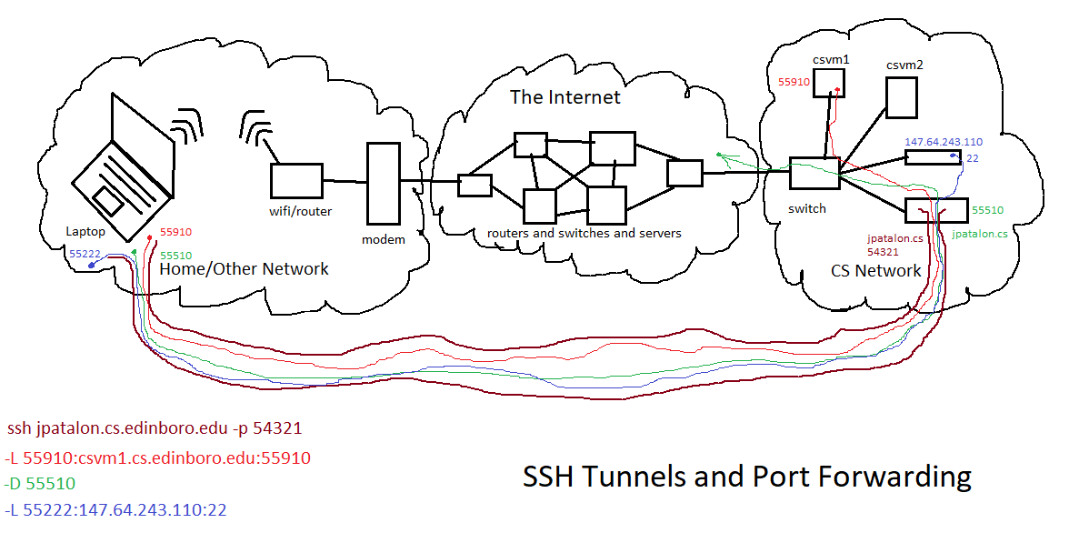

Slide 32
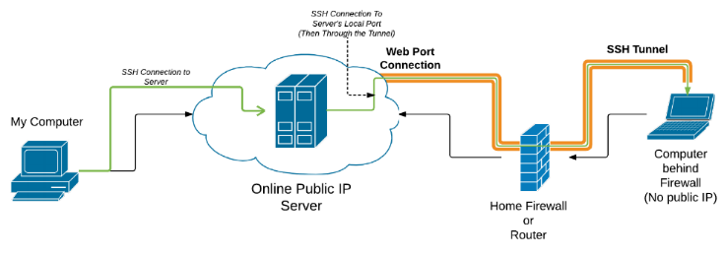
Reverse SSH Tunnel
Open an SSH connection that allows additional connections in the opposite direction!
  Ex: I open a reverse SSH tunnel from my house to jpatalon.cs.Edinboro.edu with port 32123
    ssh -R 32123:localhost:22 cs_student@jpatalon.cs.edinboro.edu -p 54321
    A tunnel from jpatalon.cs.Edinboro.edu on port 32123 will now be forwarded to the originating (localhost) machine port 22
    This will allow anyone to connect to localhost port 32123 on jpatalon.cs.Edinboro.edu and go through the tunnel!
    Log on to jpatalon.cs.Edinboro.edu, open a SSH connection to localhost port 32123, it is actually going to my machine!
      Yeah you don’t have an account, so you can’t login.
    This only works while my SSH tunnel is open!

Slide 33
Reverse SSH Tunnel
Open an SSH connection that allows additional connections in the opposite direction!
  How about multiple tunnels?
    I run this from my machine: Reverse tunnel on jpatalon port 32123 to my house on port 19999, and port 32122 to port 22…
      ssh -R 32123:10.11.187.1:19999 -R 32122:localhost:22 cs_student@jpatalon.cs.edinboro.edu –D 54321
    You can then connect to http://localhost:32123 and access the netdata instance behind it, on my local network…
      Open a local proxy from anywhere to jpatalon.cs.Edinboro.edu…
      ssh -L 32124:localhost:32123 cs_student@jpatalon.cs.edinboro.edu –D 54321
      Open a browser connection to http://localhost:32124 !
        Localhost port 32124 goes through
        your SSH tunnel to jpatalon localhost port 32123
        Jpatalon localhost port 32123 goes through
        my SSH tunnel to 10.11.187.1 port 19999
          Jpatalon localhost port 32122 goes through
          my SSH tunnel to the originating localhost server port 22
        You are connecting to the Netdata instance on my local network!
    This still only works while my SSH tunnel is open!

Slide 34
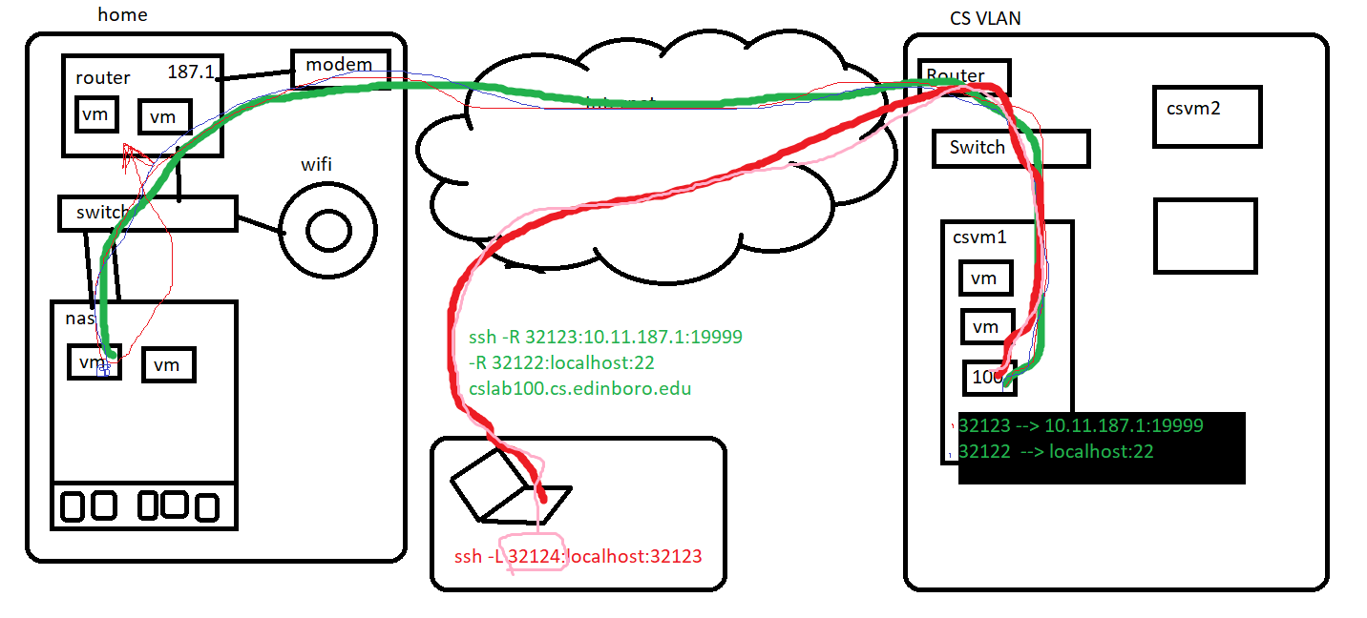
Reverse SSH Tunnel

Slide 35
DNS Server Settings
File: /etc/named.conf
  Options:
          listen-on port 53 { any; };
          listen-on-v6 port 53 { any; };
          allow-recursion {
127.0.0.1;
::1;
147.64.243.96/27;
192.168.0.0/24;
192.168.1.0/24;
10.11.0.0/16;
10.0.187.0/24;
};

Slide 36
Backups
Evaluate backup needs
  Amount of data to back up
    Full, incremental, differential, clone…
  Backup hardware and devices
    Dedicated backup hardware, servers, media, drives, etc.
  Necessary/Available network interface
    Client speeds, concurrent backups, continuous backups
  Recovery options and information
    Speed, duration, procedures
  Media management
    On-site and Off-site rotation
  Additional features
    Deduplication
    Encryption
    Compression

Slide 37
Backup Script & Cron Job Example
Script – /root/backups.sh:
#!/bin/bash
rsync -avz --delete /root /backups/
rsync -avz --delete /home /backups/
rsync -avz --delete /etc /backups/
rsync -avz --delete --exclude "empty" /var /backups/
Don’t forget to set the script executable!
chmod +x /root/backups.sh
Cron – Run nightly at 2:00AM:
crontab -e to edit
0 2 * * * /root/backups.sh

Slide 38

Midterm Review
Assignment 8
https://jpatalon.cs.edinboro.edu/cmac3990/Assignment%208.pdf
What is the economic impact of your midterm grade?
  What does that even mean?
    I don’t know.
We will review this during a class before and/or after the midterm.
  Later?
  Today?!
  Now!
  Then.
  All of the above??

Slide 39
Assignment 9???
Extra documentation!
  Command Log - A log of the specific commands you ran, in order. Include a minimal description of the command.
  Project Work Log - Include dates, time spent on tasks, description of activities
  Detailed instructions in plain English of what you are doing - Describe what was done and why.
  Description of your server’s functionality - Overview of what services does your machine offers.
Key configuration items
  NFS, DNS, Netdata, Network Interfaces, Apache, rsync, cron, backups, etc…
  Most everything detailed in today’s slide deck
    Specific ports or addresses may be different in the assignment!!!
Details TBD…
Due Oct 19??

Slide 40

Assignment 9 Rundown?
Assignment 9 Rundown – Backups, VIP & VLAN, NFS
  Documentation
    Project Work Log
    Command Log
    Detailed Instructions
    Description of Functionality
  Configuration
    Enp0s3, enp0s8, bond0, Virtual IP interface bond0:0
    Virtual LAN interface bond0.6, bond0.110, bond0.187
    NFS Client Mount and NFS Server Export
    Netdata
    New DNS records private1, private2, ipv6
    Tiger VNC
    Compile Apache from Source
    Backup script and cron job
    Updates and reboot
    Check script!
Details TBD!

Slide 41
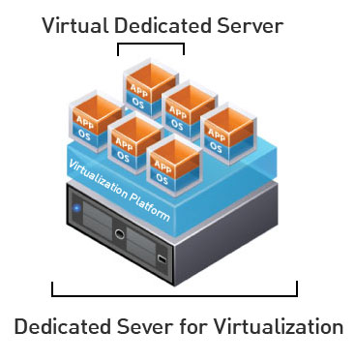
Virtual Machines
VM Info:
  IP Address: 147.64.243.1##/23 (20-23) – bond0
  Hostname: ecsc425-1##.cs.edinboro.edu (20-23)
  Alias: 41##.megastuff.biz (20-23)
  Samba: \\147.64.243.1##\ (20-23)
  Additional IP’s:
    bond0:0 - 147.64.243.50+##/23
    bond0.6 - fd06:1234:5678:beef:1##::1/64
    bond0.110 – 10.10.1##.1/16
    bond0.187 10.0.187.#/24
Assignment 9
  Multiple configuration tasks, combining various topics from throughout the semester
  NFS, DNS, VNC, Apache, Netdata, backups…
  Extra documentation required!
  Instructions
    https://jpatalon.cs.edinboro.edu/cmac3990/Assignment%209.pdf
  Due October 12th - run check script!
    https://jpatalon.cs.edinboro.edu/cmac3990/classfiles/assignment9-check.sh
Interfaces after Assignment 9:
  eth0, eth2, bond0, bond0:0, bond0.6, bond0.110, bond0.187

Slide 42
Linux Commands
cp
ifdown
ifup
virsh
virsh list --all
systemctl
wget
virt-install
ps
dnf
docker
firewall-cmd
netstat
chroot

Slide 43

Key Terms and Items
continuous backups
snapshot backups
hot/cold backups
compression
deduplication
encryption
backup fire drills
DFS
disaster recovery
platter
spindle
track
cylinder
sector/block
heads
seek time
drive controller
HBA
RAID levels
physical volume
volume group
filesystem
hot spare
DAS
SAN
LUNs
IOPS
Types of storage monitor
full backups
incremental backups
differential backups

Slide 44

For Next Week
“A place for everything, everything in its place.” –Benjamin Franklin
Textbook:
  Chapter 9: Cloud Computing
  Chapter 23: Configuration Management
  Chapter 26: CI/CD
Next half topics
  Change management!
  Containers!
  Other network services!
  Cloud!
Continuing work with VM’s
  Assignment 7 due this Friday!
Mid-Term on Tuesday!
Just about half way?!

